Slide 1
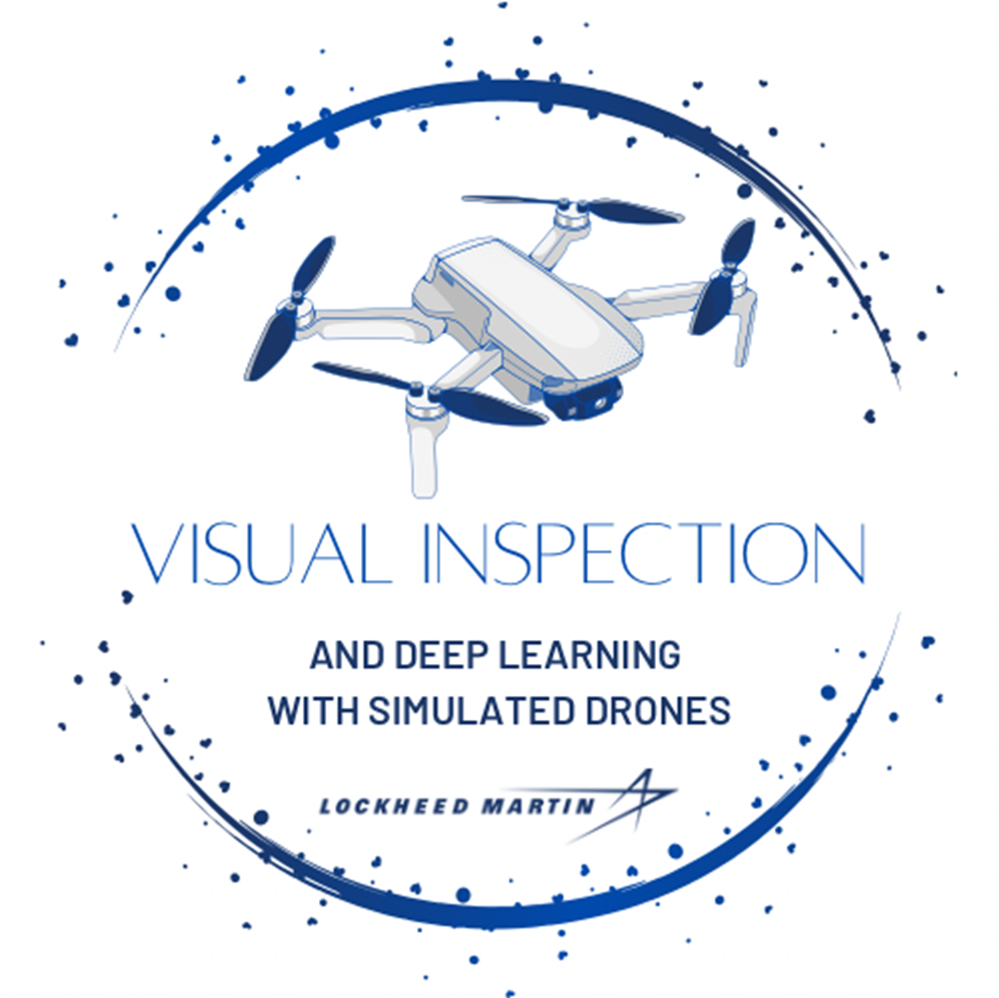
Visual Inspection and Deep Learning Team
DroneVQA: Visual Question Answering AI Model Deployed on Simulated Quadcopter Drones
Notes:
Jennifer

Slide 2

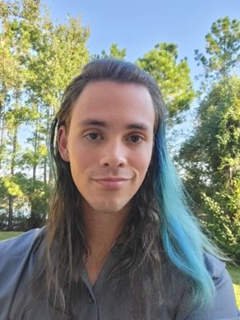
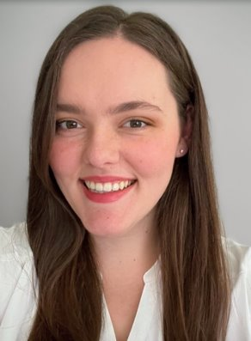
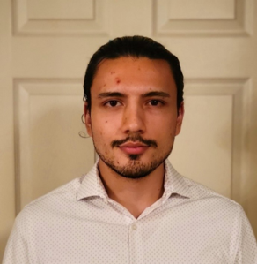
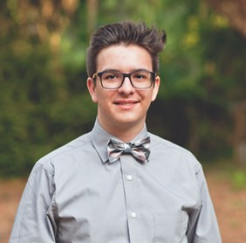

Our Team
Brandon Spangler,
AirSim Lead
Samuel Hearn
Jennifer Olenchak,
Project Manager
Robin Perlman,
AI Lead
Senior Design Group
Computer Science Majors
University of Central Florida
Ayden Rebhan
Marco Peric
Notes:
ALL

Slide 3
Mission
Create Real-Time VQA system to answer questions from drone camera
Create an application to interface with Microsoft AirSim
Have explainable AI features, such as model attention visualization and object detection visualizations.
Display top model results to user
Log results of VQA application to file for future review
Create VQA dataset from Microsoft Airsim environment and fine-tune model
Notes:
Brandon

Slide 4
Requirements
Create a GUI application with Python
Select multimodal vision-language transformer(s) for real time VQA
Create a dataset from Microsoft AirSim environment
Finetune model with dataset
Utilize AirSim API within GUI application to control drone and obtain live feed
Create visualizations of transformer model predictions and display top results to users
Notes:
Ayden

Slide 5
Current Progress
Create a Proof-of-Concept Demo application
Select two multimodal vision-language transformers
Create Jupyter Notebooks with model inference example for both models
Develop dataset specifications and question formats (*)
Familiarize with Microsoft AirSim API
Currently developing full GUI application (*)
Notes:
Marco
Have Marco explain the dataset specification, but its in the senior design final doc submission under the heading "Dataset Specifications". We also want feedback on how large our dataset should be.. We are currently saying a minimum of 250 images with 3 questions each.
Although we created a simple POC demo, the GUI software we used would not be suitable for the final results. We are remaking it with PySide6 and QT framework because it will be more capable of handling the multitude of goals we have for the final project.

Slide 6
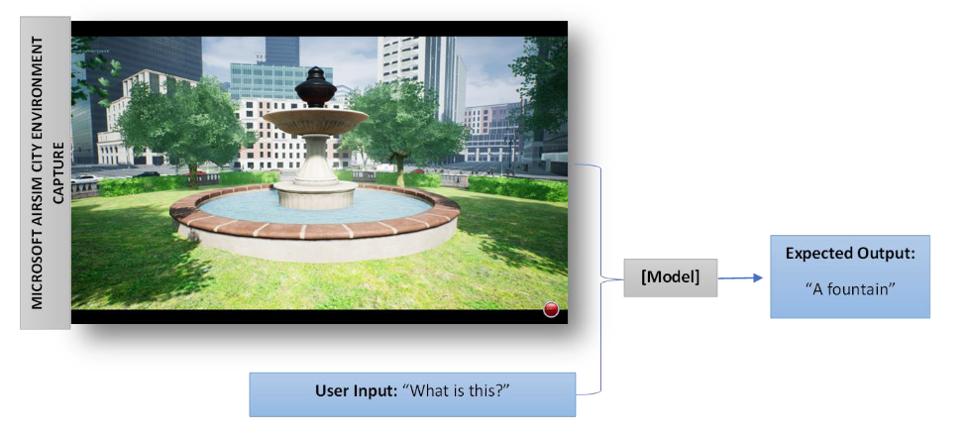
System iNTERACTION
Notes:
Sam
The answers are derived from classification

Slide 7
Question Types
Scene Classification
Where am I?
How is the weather?
What season is it?
Attribute Classification
What color is the car?
What type of building is this?
Counting (*)
Camera Anomaly and Image Integrity Detection (*)
Is the camera blurry?
Is there any pixel corruption?
Is there anything blocking the camera?
Notes:
Sam
For counting problem, our VQA models tend to have problems correctly answering this question when many objects are spatially close to one another. So a huge traffic jam may be difficult to obtain the correct answer..
For camera anomaly, the we plan to simulate these anomalies through our dataset by adding blur, pixel corruption, etc to the images. The goal will be to add these anomaly affects to the application screen to simulate real time blur effects, etc.

Slide 8
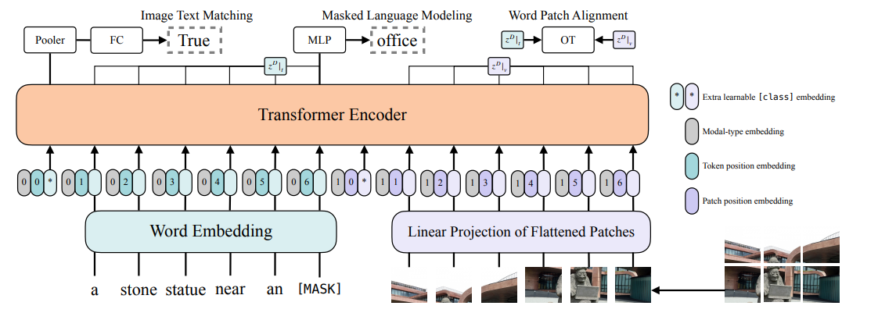
ViLT
Vision-and-Language Transformer
Computationally efficient model with simplistic architecture
Does not rely on CNN backbone for Image Feature Extraction
Notes:
Marco
Original Paper: https://arxiv.org/pdf/2102.03334.pdf

Slide 9
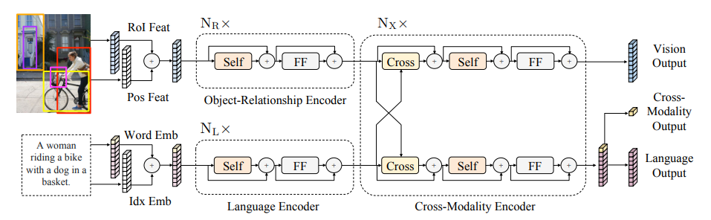
LXMERT
Learn Cross-Modality Encoder Representations from Transformers
Utilizes Faster RCNN for feature extraction. Object Detection masks can be good for explainable AI goal
Most time spent performing feature extraction. Slower than ViLT.
Can be useful when asking multiple questions about the same image, since each image only needs to be processed by Faster RCNN once.
Notes:
Marco
Original Paper: https://arxiv.org/pdf/1908.07490.pdf
Runs object detection first, so it takes longer structurally
Both models classify answers, not creating answers from scratch
Since Faster R CNN only needs to process an image once – there exists the possibility of caching

Slide 10

DroneVQA Application
Notes:
Jennifer

Slide 11
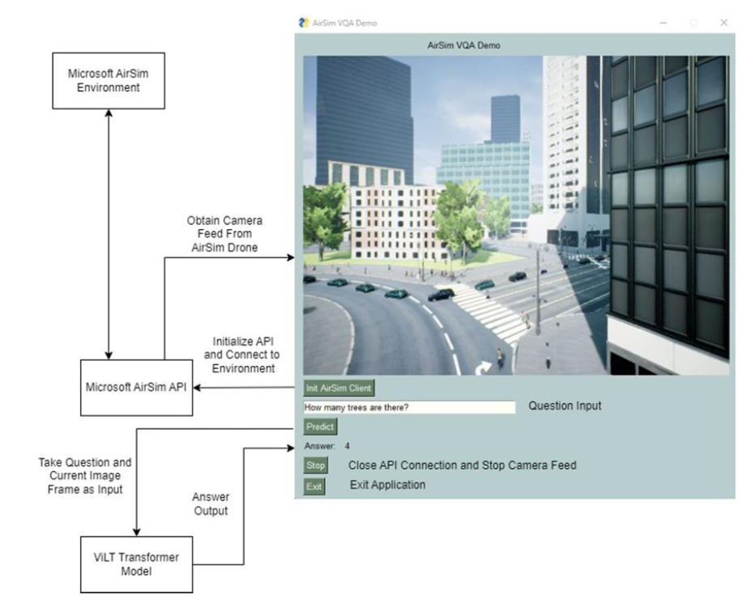
Proof of Concept Demo Application Breakdown
Notes:
Jennifer
PySimpleGUI
- This Proof of Concept Demo was initially presented to Joe earlier in the semester
- Proof of concept for the basic goal of performing VQA on a live video feed from the AirSim environment
- This simple architecture design shows a simplified view of the goals for the project

Slide 12
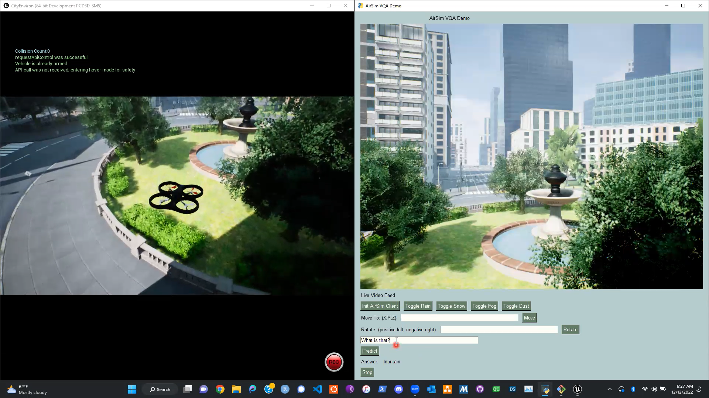
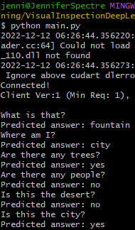
Proof of Concept Demo Application
Command-line Output Log:
Notes:
Jennifer

Slide 13
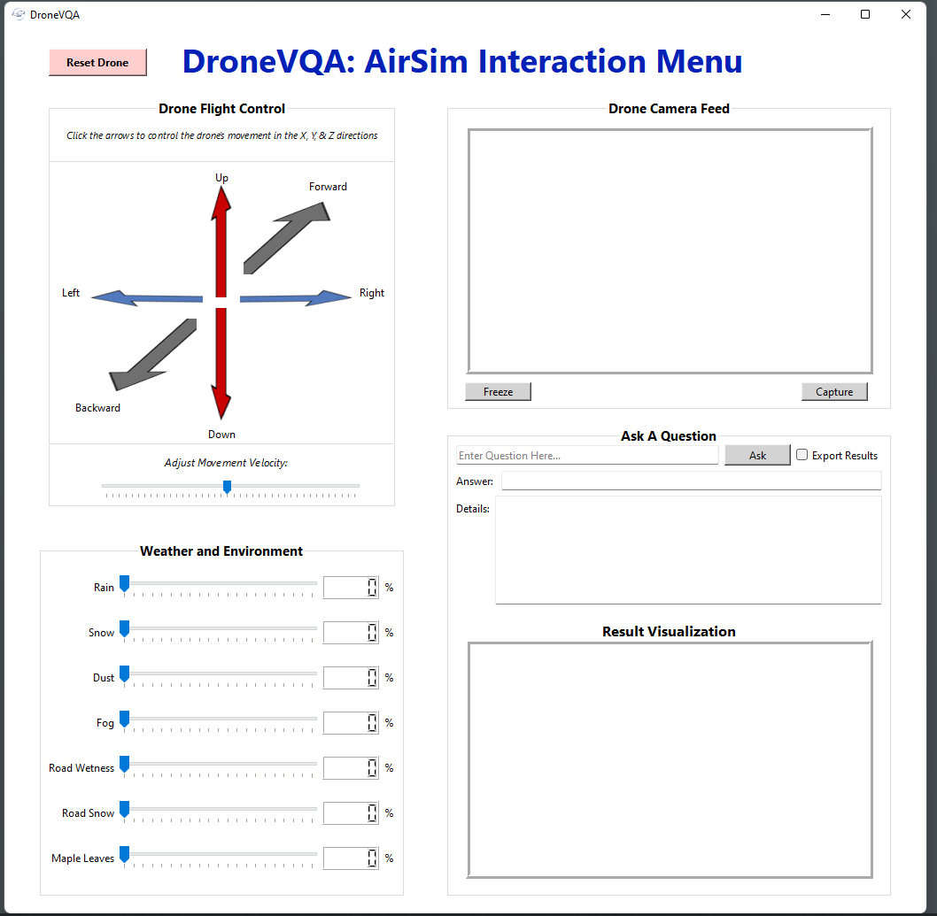
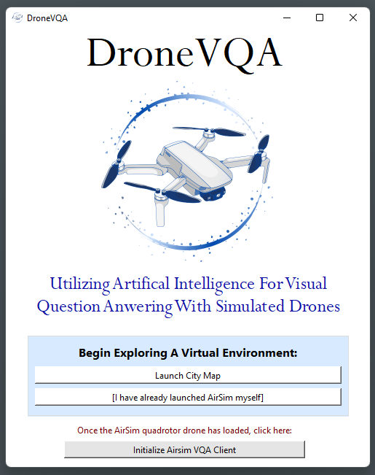
New Application
Launch Screen
VQA Interaction Menu
Notes:
Jennifer
- PySimpleGUI lacks development features
- Created using QT framework
-Using the PySide6 library
- Inherent cross-platform support
- Development in the QT Creator software
- QT-based python GUI
-Visual GUI editing
-Edit .UI files that are converted to python class equivalent at run time
-Editing of python code
Visualization
-Object detection bounding box results
-Model attention grad cam images

Slide 14
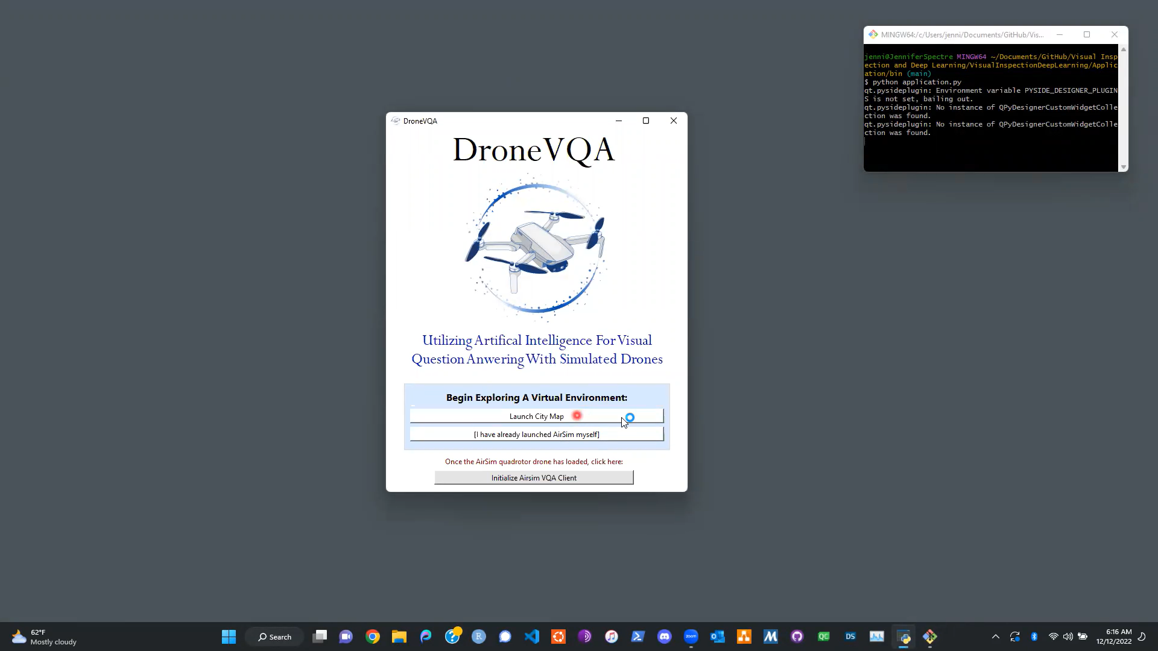
GUI Launching & Drone Moment
Notes:
Jennifer

Slide 15
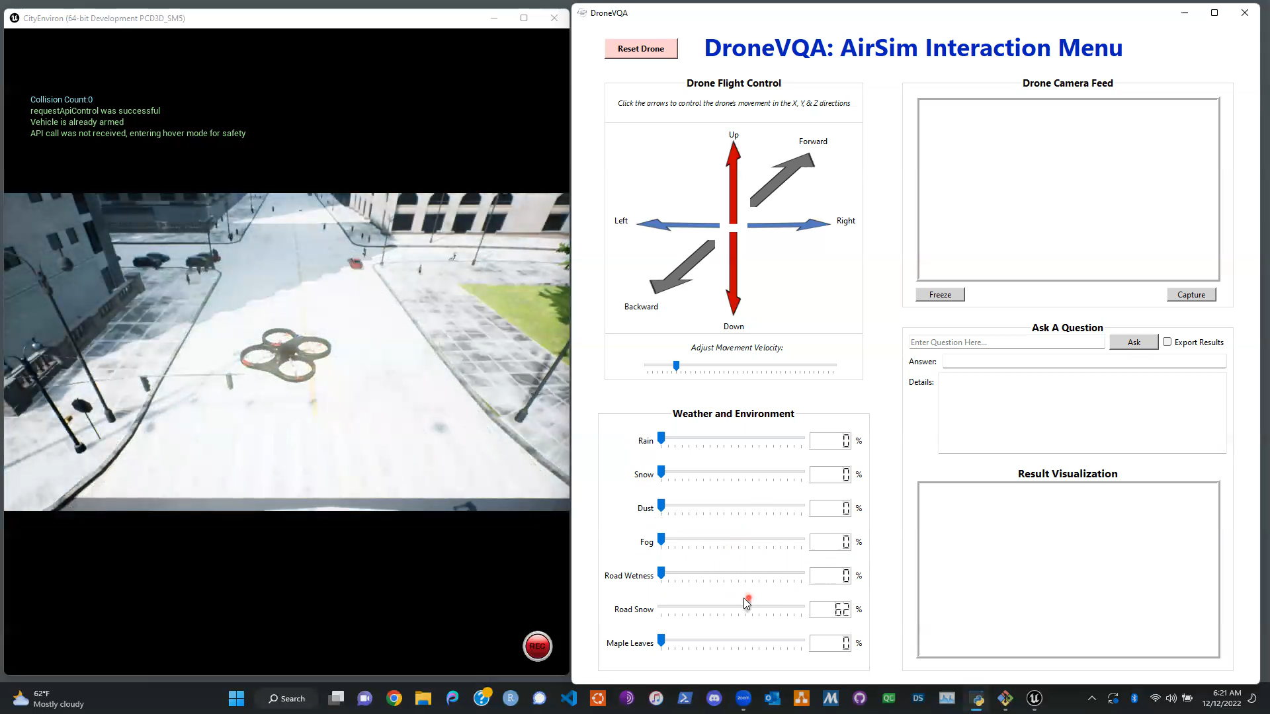
Weather Control & Drone Reset
Notes:
Jennifer

Slide 16
Plans for Future Work
Uncover methods for displaying model attention for explainability purposes.
Currently looking into Grad-CAM implementations and recent works from Facebook research (https://github.com/hila-chefer/Transformer-MM-Explainability)
Add anomaly options to application to simulate blur and pixel corruption effects in the real time video feed
Develop VQA dataset and fine-tune models
Add application option to select between models. For example, LXMERT for running multiple questions and environment analysis with more explainability visualizations and ViLT for quick responses without visualizations.
Use Pickle library to create VQA user interaction logs
Any information or suggestions about this would be welcome!
Notes:
Brandon

